Slide 1

Course Introduction Artificial Intelligence of Things (SWS3025) NUS SoC Summer Workshop 2024
Lecture 0
Lecturer: A/P TAN Wee Kek
Email: tanwk@comp.nus.edu.sg :: WeChat :: tanweekek

Slide 2

Learning Objectives
At the end of this lecture, you should understand:
The course schedule.
The assessment tasks, including the group project.

Slide 3
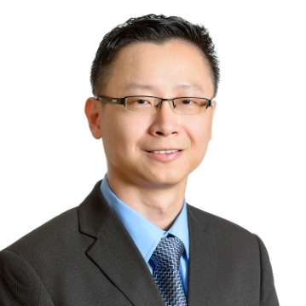
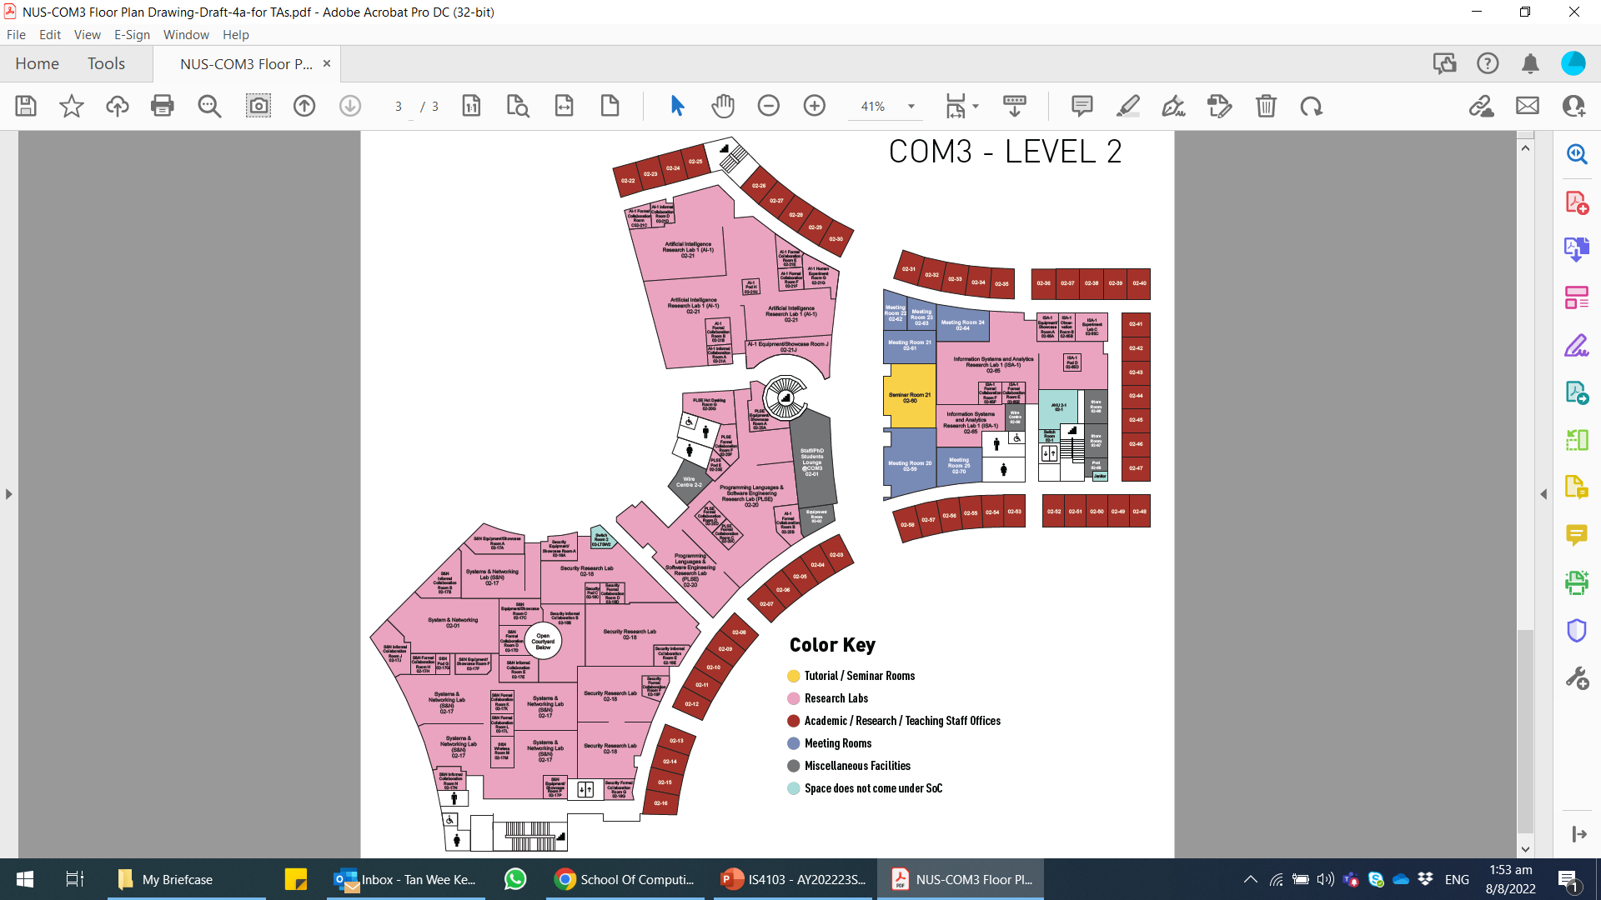
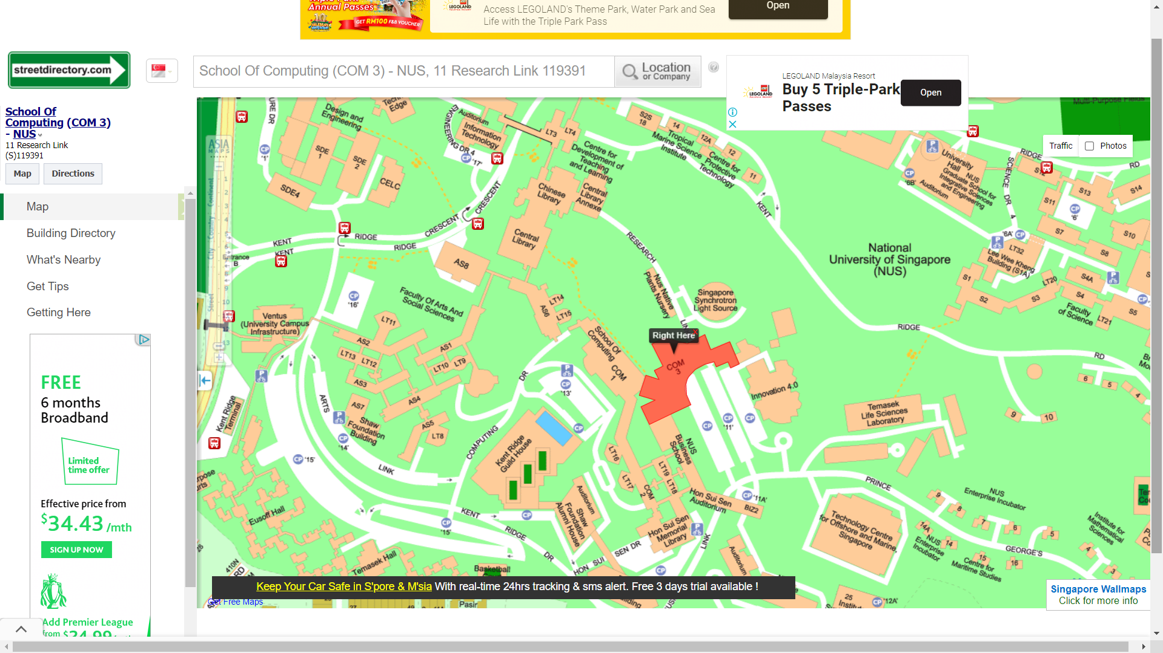
Teaching Team
Course Facilitator – A/P TAN Wee Kek（陈伟克）
Office: COM3-02-35
Contact: 6516 6731
Email: tanwk@comp.nus.edu.sg

Slide 4
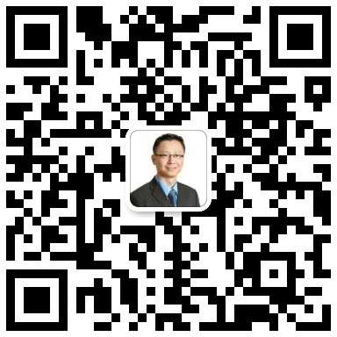
Teaching Team (cont.)
My WeChat ID is tanweekek:

Slide 5
Course Synopsis
Artificial Intelligence of Things (AIoT) lies at the intersection of Artificial Intelligence (AI) technologies and Internet of Things (IoT) infrastructure. AIoT aims to achieve smart IoT operations that optimise human-machine interaction, and data management and analytics.
More specifically, IoT is set to disrupt the way we live and work. Smart homes that are filled with connected devices are loaded with endless possibilities to make our lives easier, more convenient, and more comfortable. Industry 4.0, which is powered by Industrial IoT (IIoT), promises to turn smart manufacturing and smart factory into a reality.
IoT devices are expected to generate a huge volume of data. AI techniques such as machine learning and deep learning can help individuals and organisations alike to realise unprecedented business values from these data.
In this course, you will learn how to work with single-board microcontrollers and computers in conjunction with various connected devices such as sensors, actuators, smartphones, smartwatches, Bluetooth Low Energy beacons, and other interesting hardware to build various smart home and industry scenarios. You will also learn how to integrate a real-time data pipeline for visualising and analysing the data that are collected by these devices to create a smart AIoT system.

Slide 6
Course Synopsis (cont.)
AIoT
Software Engineering
Hardware Prototyping
AI Machine Learning

Slide 7

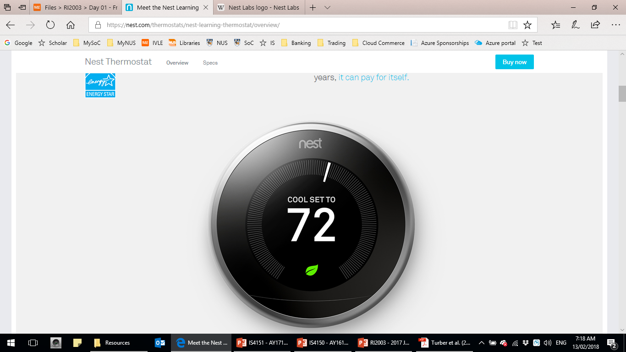
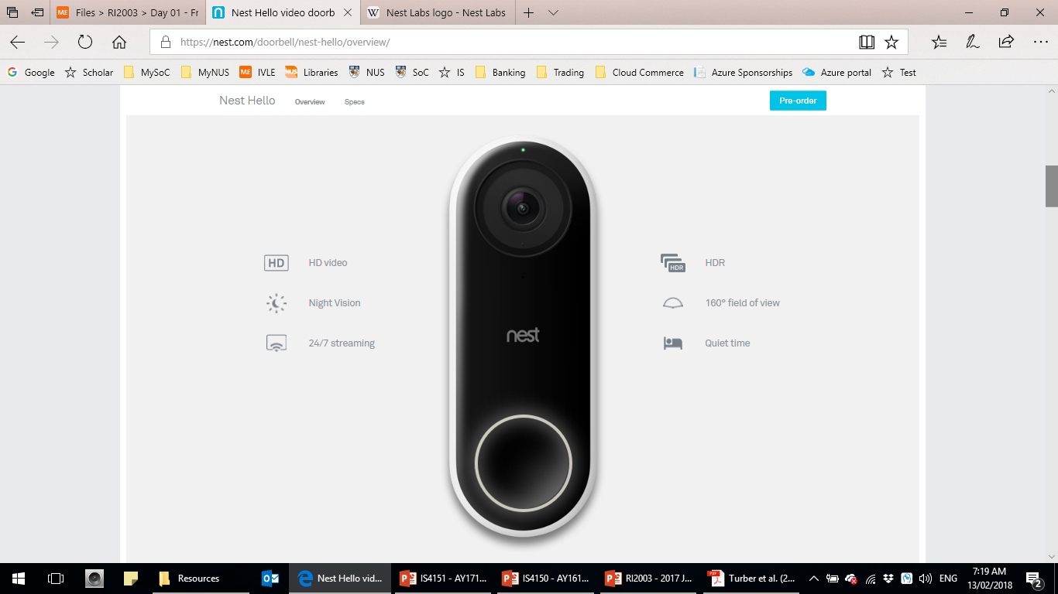
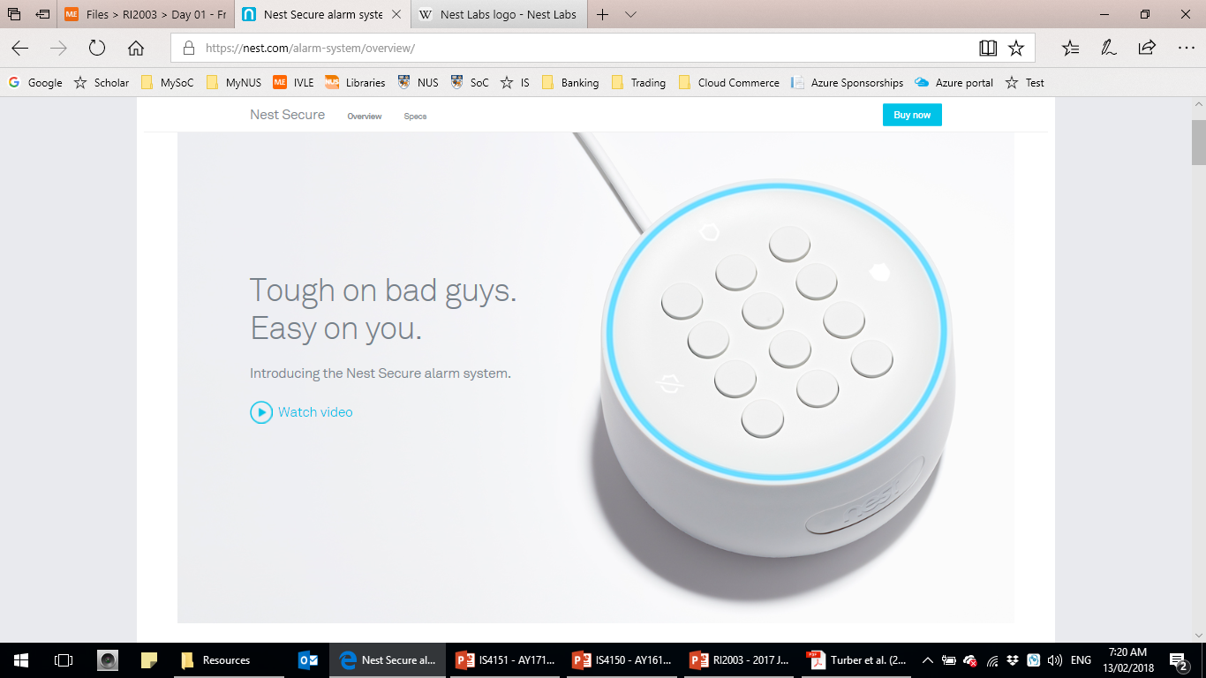
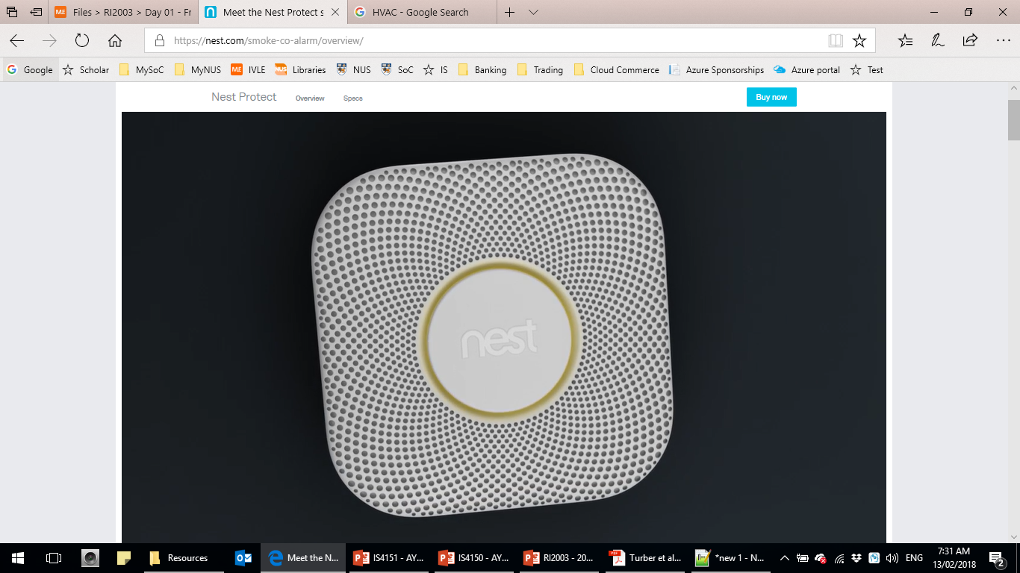
Opening Case
Nest Labs is a home automation producer of programmable, self-learning, sensor-driven, Wi-Fi-enabled devices:
It introduced the Nest Learning Thermostat in 2011 as its first product.
This was quickly followed by smoke detectors, security cameras, and other security systems.
Relies on sensors and algorithm for self-learning capability and also capable of self-communication among devices.

Slide 8
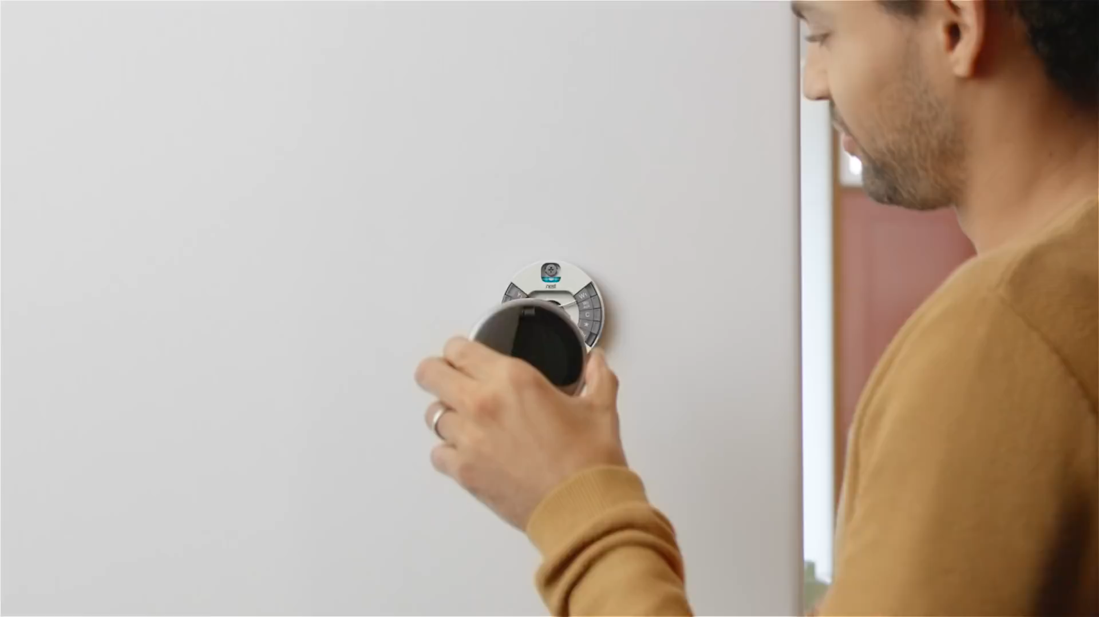
Opening Case (cont.)

Slide 9
Course Schedule
Morning – 9 am to 12 noon
Afternoon – 2 pm to 5 pm
Phase | Date/Time | Topics | Key Activities
Intro Lectures | Sun 19 May, Morning | 0 – Course Introduction | Preliminary assessment
 |  | 1 – Introduction to Artificial Intelligence of Things (AIoT)
 |  | 2 – Single-board Microcontroller (I)
Actual Lectures | Tue 2 Jul, Morning | 3 – Single-board Microcontroller (II) | Project Kickoff
 |  | 4 – Single-board Computer (I) | -
 | Tue 2 Jul, Afternoon | 5 – Single-board Computer (II)

Slide 10
Course Schedule (cont.)
Phase | Date/Time | Topics | Key Activities
Actual Lectures | Wed 3 Jul, Morning | 6 – IoT Backend Integration (I) | Prepare Project Proposal
 | Wed 3 Jul, Afternoon | 7 – IoT Data Preprocessing
 | Thu 4 Jul, Morning | 8 – Machine Learning for IoT Data (I) | Submission of Project Proposal
 | Thu 4 Jul, Afternoon | Collection of Equipment | Please form your project group beforehand as the equipment is issued at the group-level.

Slide 11
Course Schedule (cont.)
Phase | Date/Time | Topics | Key Activities
Actual Lectures | Fri 5 Jul, Morning | 9 – Machine Learning for IoT Data (II) | Review of Project Proposal
 | Fri 5 Jul, Afternoon | 10 – Machine Learning for IoT Data (III) – Computer Vision
Project | Mon 8 Jul Onwards | - | Commencement of Project

Slide 12
Topic Selection
Topic selection will be done in the week of 27 May.
Only students who eventually select this topic would be issued with hardware equipment.

Slide 13
Assessment
The course assessment is divided into two phases:
Preliminary assessment for Introductory Lectures phase:
Quiz consists of MCQs and short structured questions.
Phase | Assessment Component | Weightage
Introductory Lectures | Quiz | 20%
Actual Lectures | Group Project | 80%
Total |  | 100%

Slide 14
Group Project
Conceptualise, design and develop an AIoT project:
Must demonstrate both elements of IoT and AI.
Can be any business domain or industry.
The group size is 4 students.
Each group of students would be issued with a set of standard project equipment.
More details would be provided during project kickoff in July.

Slide 15
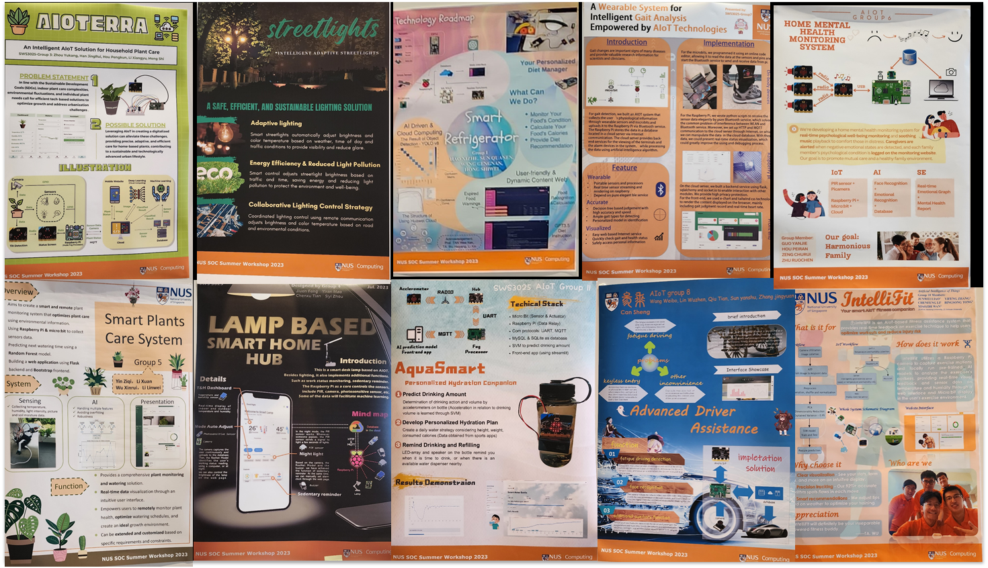
Sample Projects
SWS3025 July 2023 (Physical) – 10 Projects

Slide 16
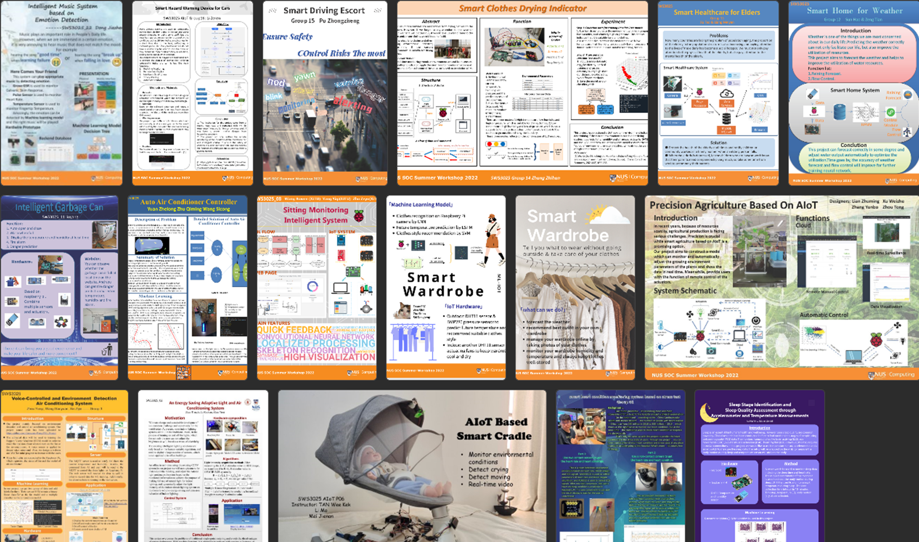
Sample Projects (cont.)
SWS3025 July 2022 (Online) – 21 Projects

Slide 17
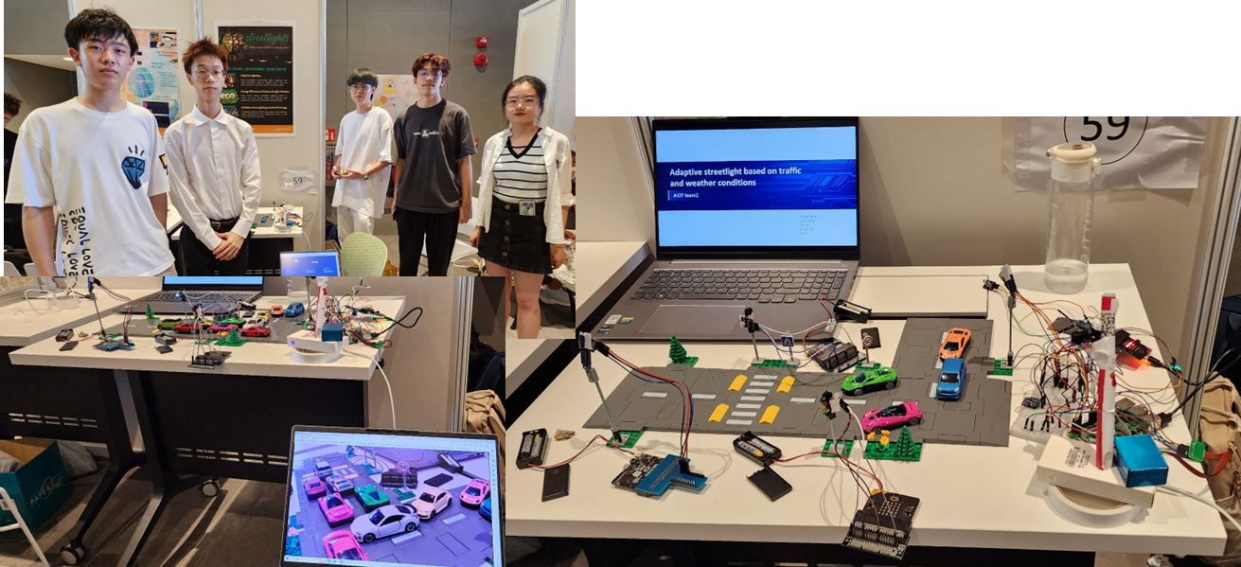
Sample Projects (cont.)
SWS3025 July 2023 – AIoT – Intelligent Adaptive Streetlights (First Prize 一等奖)

Slide 18
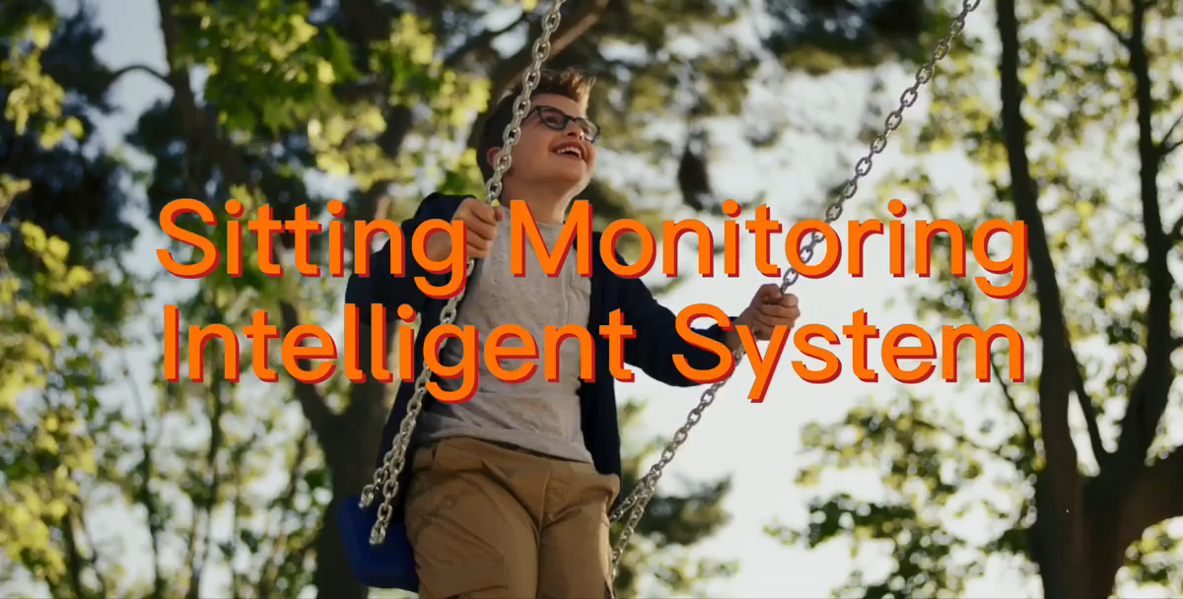
Sample Projects (cont.)
SWS3025 July 2022 – AIoT – Sitting Monitoring Intelligent System (First Prize 一等奖)

Slide 19

Sample Projects (cont.)
SWS3025 July 2021 – AIoT – Smart Water Bottle (First Prize 一等奖)

